Slide 1

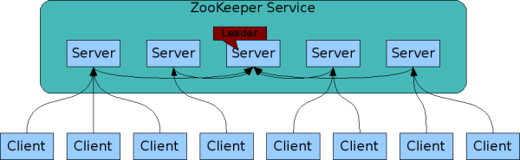
Zookeeper Introduction
A Distributed Coordination Service for Distributed Applications
Demo use zkCli command
Follower
Distributed application. Ex Hadoop, HBase

Slide 2
Zookeeper Group Membership
A distributed HA service
When launch the service, zookeeper will elect a leader, others are followers
When a leader break down, zookeeper will re-elect a leader for failover
Zookeeper at least need to deploy 3 machines, for leader and follower

Slide 3
Zookeeper Consistency
Client send request to local zookeeper
Write request
If follower, forward request to leader, if leader approve and save data, then broadcast to followers to update
Read request
Response by local zookeeper
All server data keep in memory
Low latency
Do snapshot saved in disk

Slide 4
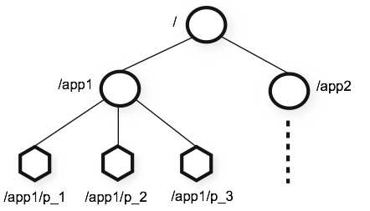
Zookeeper Data (ZNode)
Like file system (inode)
Naming service
Atomic access (read /write)
Watch ZNode event
Node Type
Persistent
Ephemeral
In-Memory

Slide 5
Zookeeper Use Case
A distributed lock service
If distributed application need distributed lock to sync. Ex. If multiple user update the same data
A configuration service
If distributed system need to save system status or global properties

Slide 6
Thanks for your attention

